Slide 1
Advances in open-source software for 3D electromagnetics using SimPEG
L. Heagy¹, J. Kuttai¹, D. Cowan¹, J. Capriotti^{1,2}, S. Kang³, D. Fournier⁴, D. Oldenburg¹
¹University of British Columbia Geophysical Inversion Facility
²Colorado School of Mines
³Stanford Geophysics
⁴Mira Geoscience

Slide 2
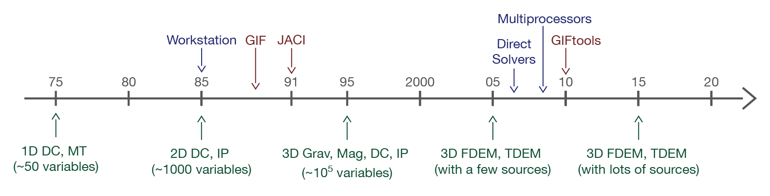
some background: UBC-GIF
GIF Fortran Codes & GIF Tools
slide from: Oldenburg, 2016: Looking back and moving forwards (BIRS)

Slide 3
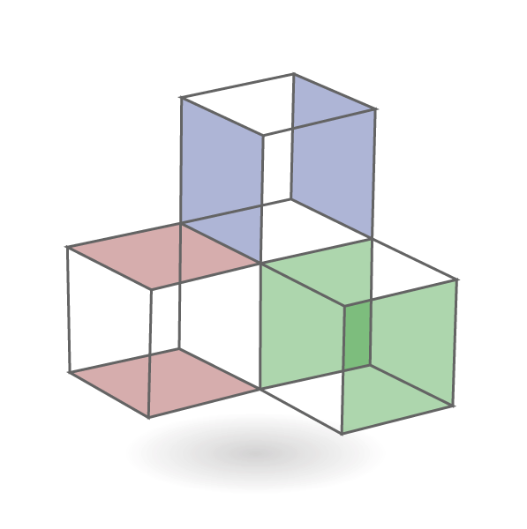
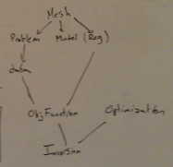
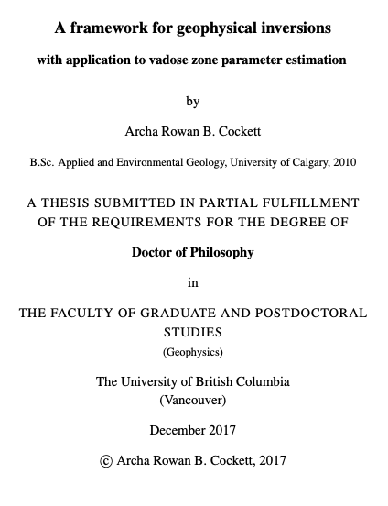


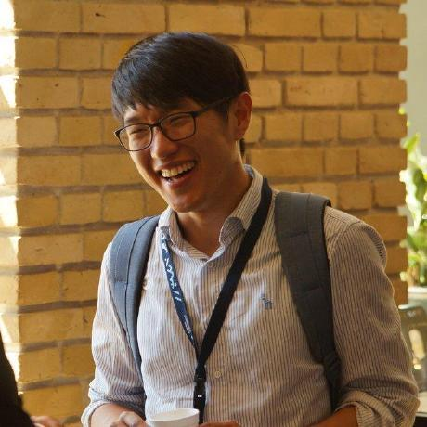
some background: UBC-GIF
Transition to open-source
In 2013… started SimPEG
By 2010’s…
most forward simulations “solved”
next generation of research in inversions
physical properties: anisotropy, high contrasts, magnetic permeability, IP in EM
experimenting with inversion methods: choice of norm, including physical property & geologic information
role of machine learning
…
goal: common framework for inversions in geophysics to serve researchers
R. Cockett
L. Heagy
S. Kang

Slide 4
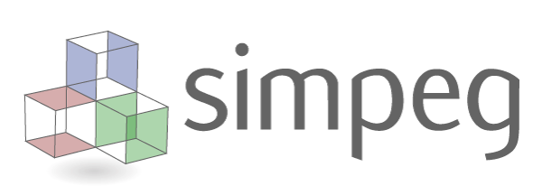
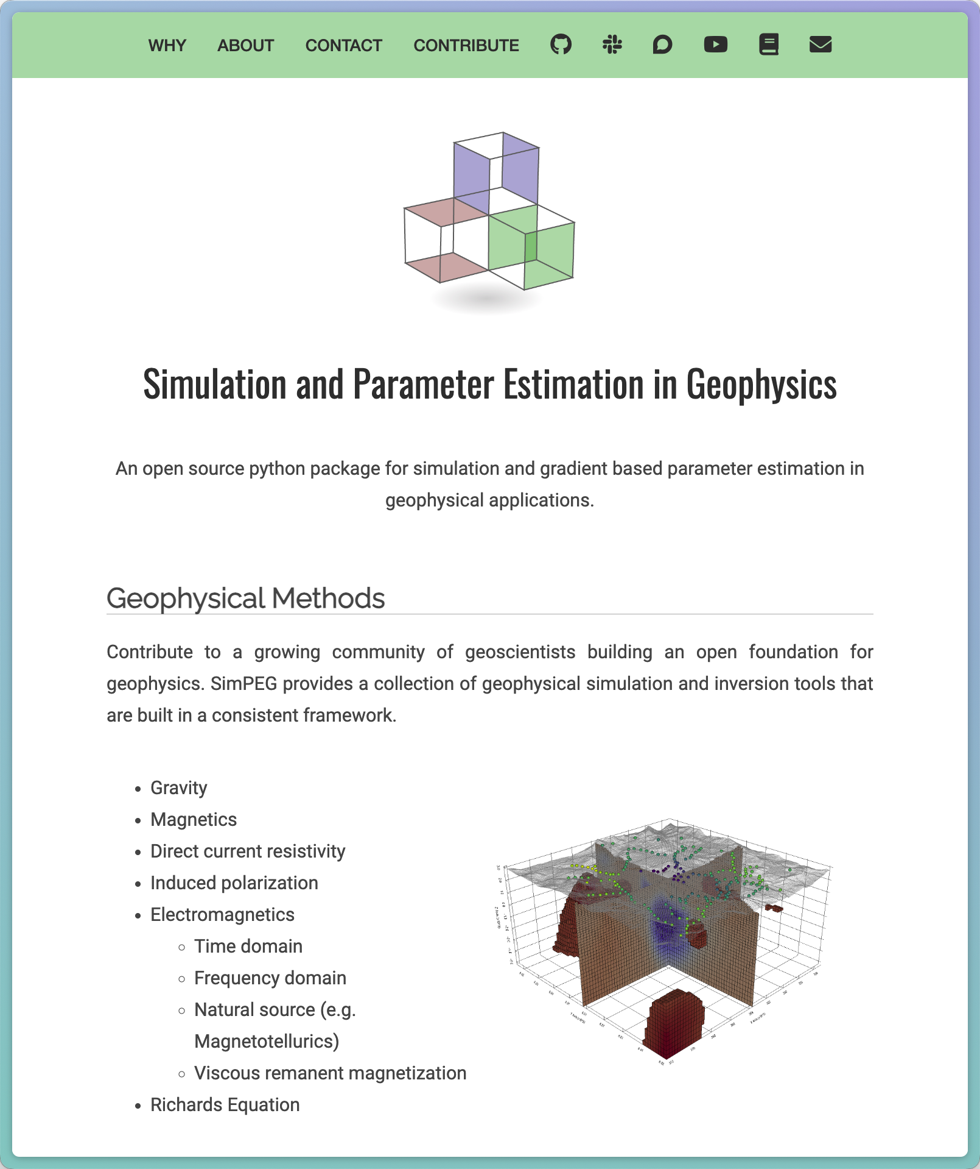
simulation and parameter estimation in geophysics
common framework for simulations & inversions
accelerate research: build upon others work
facilitate reproducibility of results
build & deploy in python
open-source

Slide 5
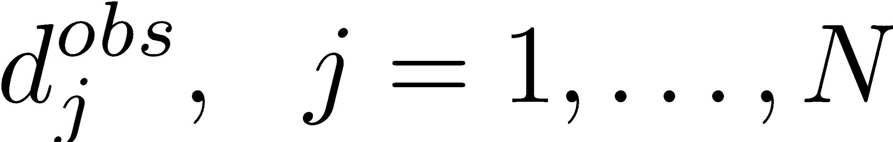
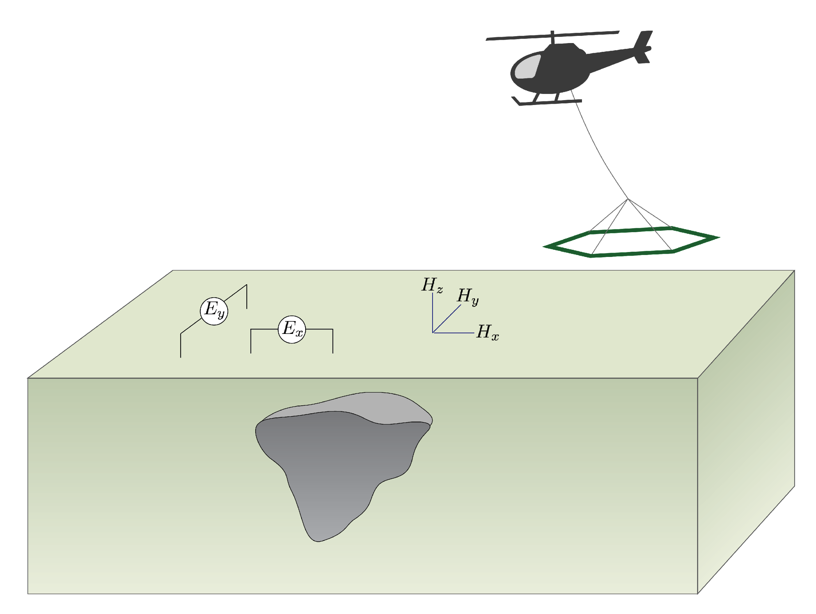
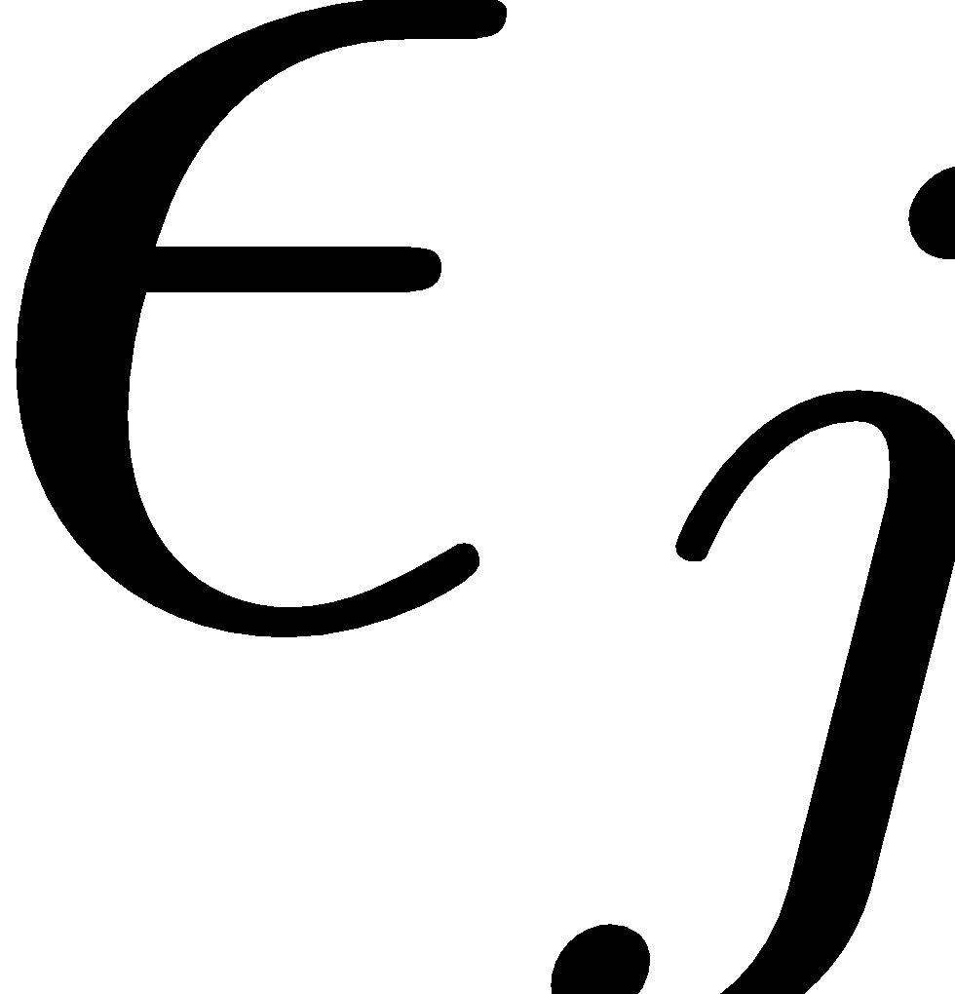
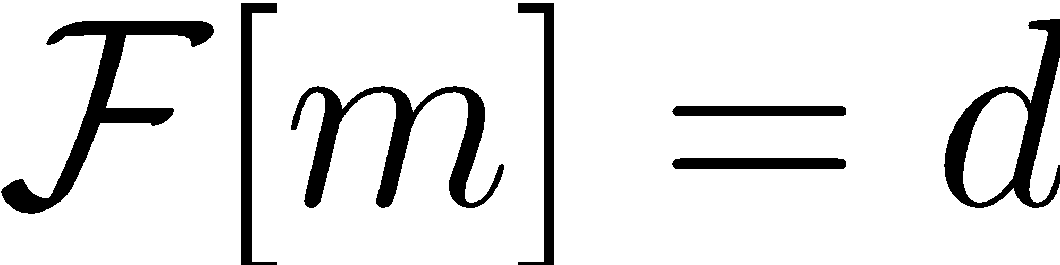
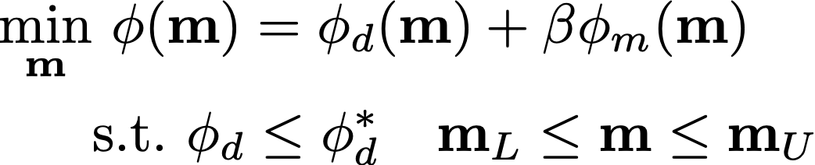
what simpeg solves
Given
observations:
uncertainties:
ability to forward model:
Inverse problem: Find an Earth model that fits those data and a-priori information

Slide 6
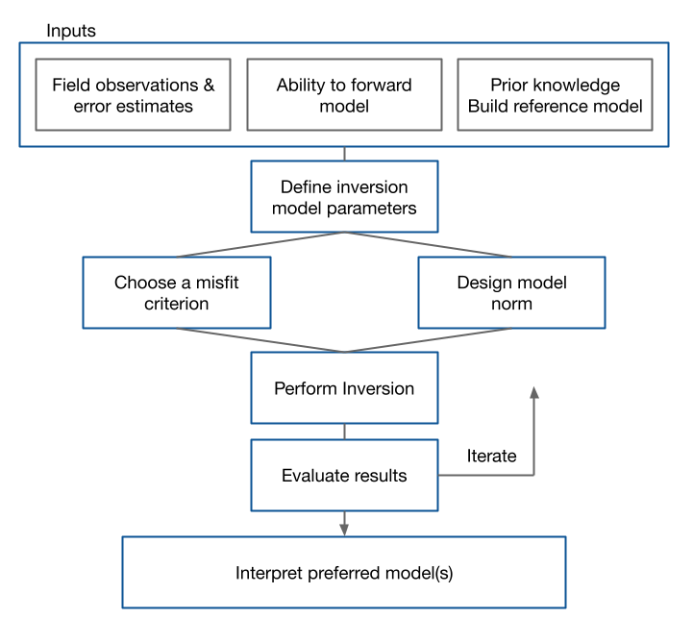
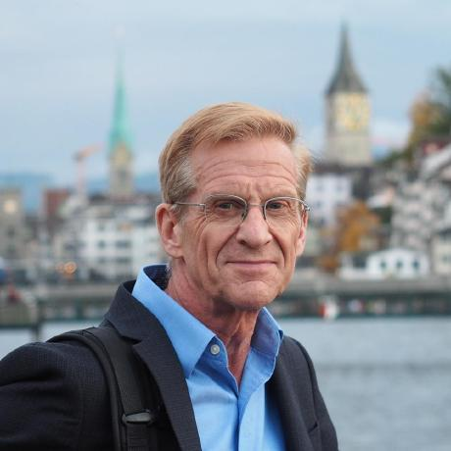
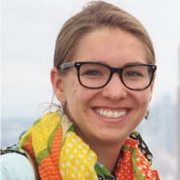

flow chart for the inverse problem
many components
iterative process to obtain solution
each component requires evaluation, adjustment by user
Fundamentals of Inversion – D. Oldenburg
Capturing knowledge in code – L. Heagy
http://www.mtnet.info/EMinars/EMinars.html

Slide 7
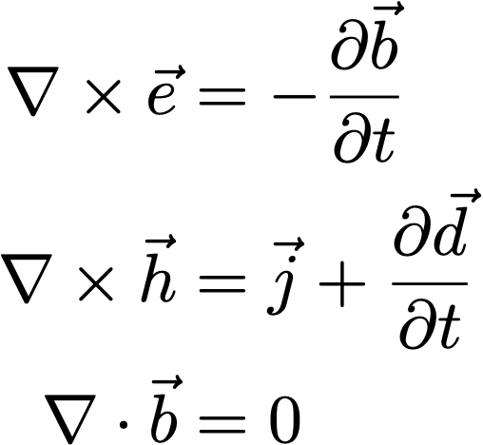
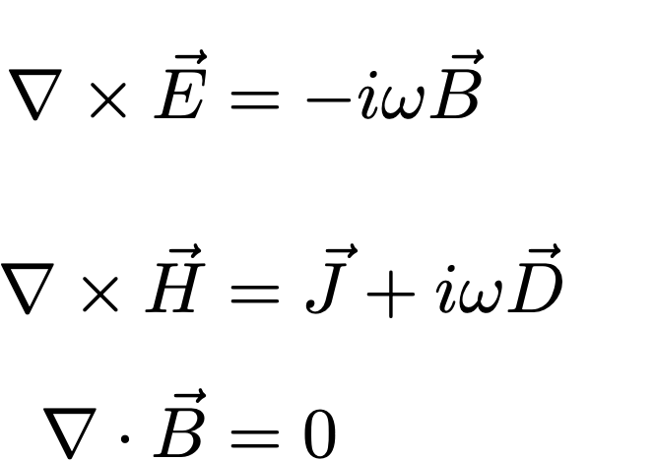
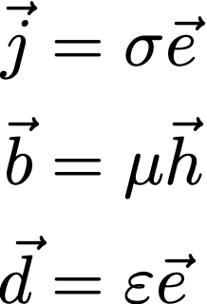
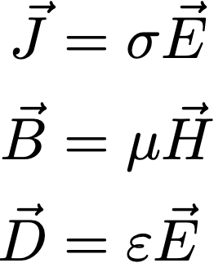
electromagnetics: basic equations (quasi-static)
Time
Frequency
Faraday’s Law
Ampere’s Law
No Magnetic Monopoles
Constitutive
Relationships
(non-dispersive)
* Solve with sources and boundary conditions

Slide 8
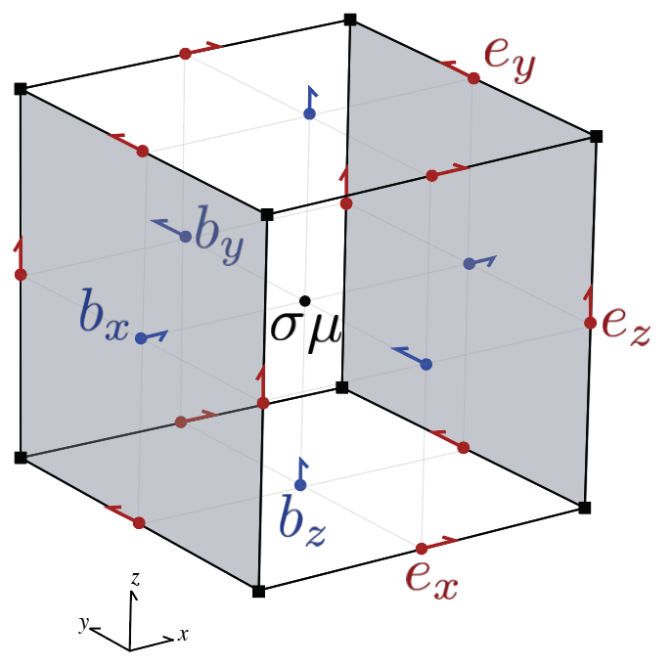
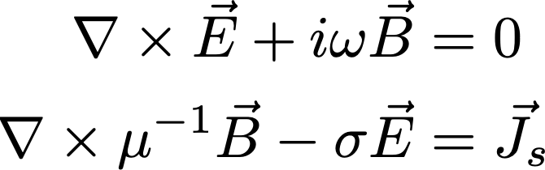
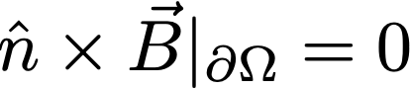
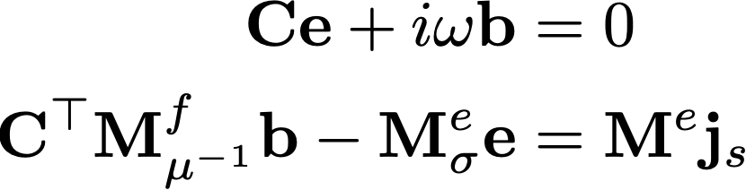
electromagnetics: frequency domain equations
Use constitutive relations, reduce to two equations, one field, one flux
Finite volume discretization (e.g. Haber, 2014; Cockett et al., 2016)

Slide 9
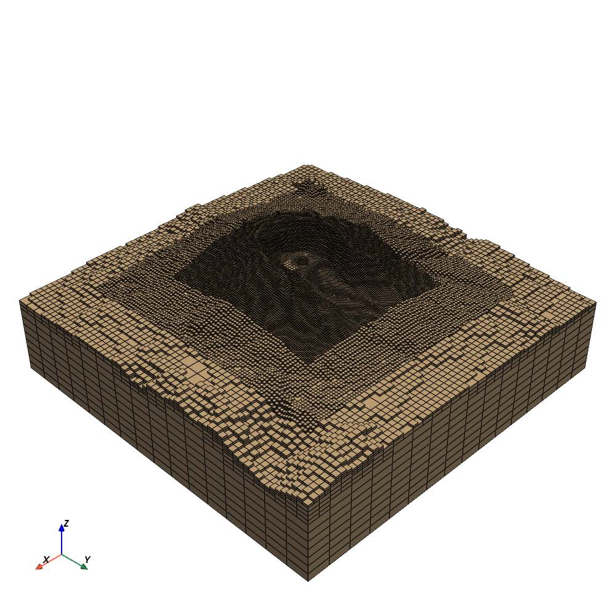
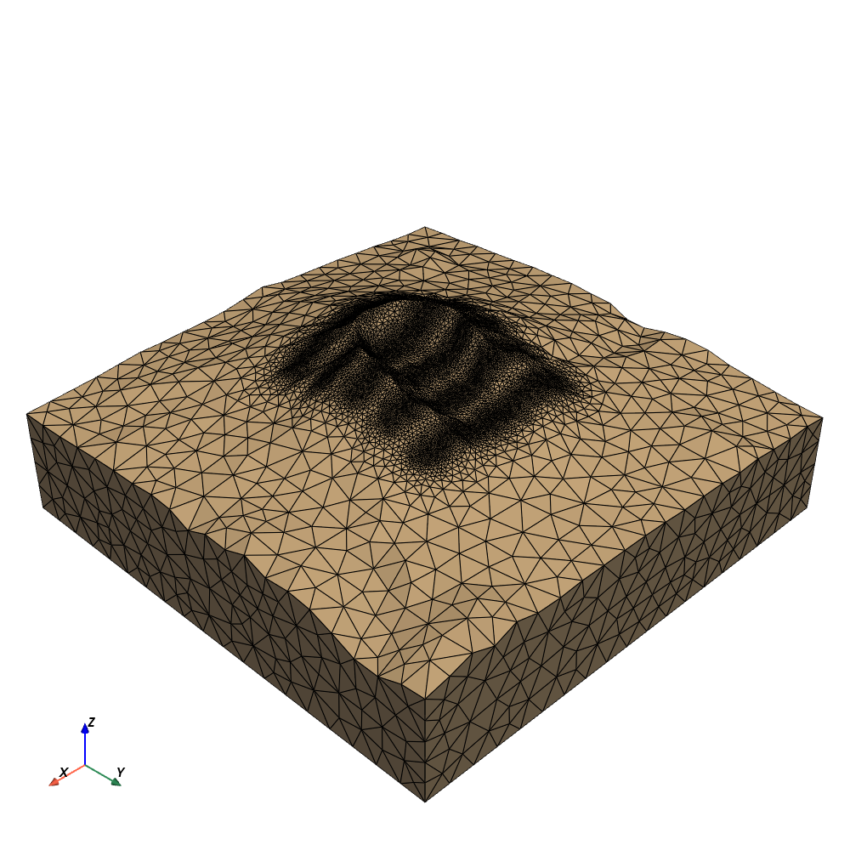

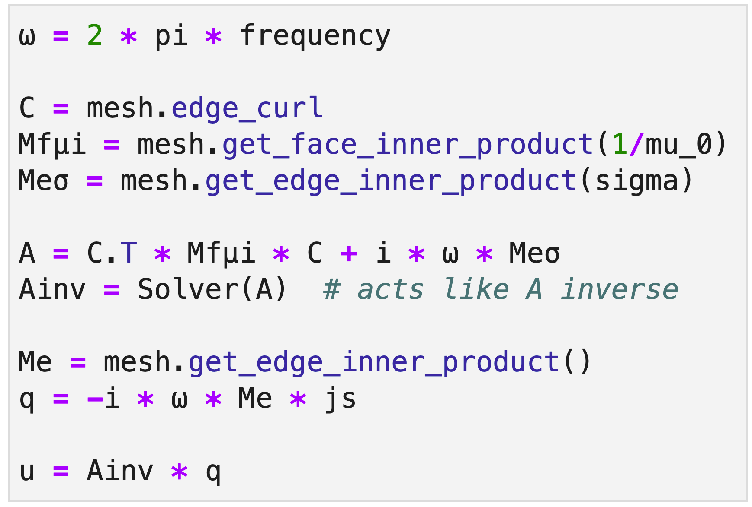
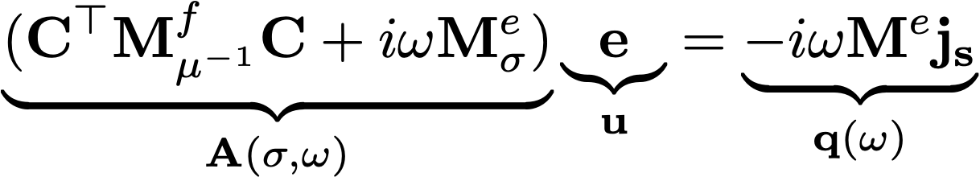
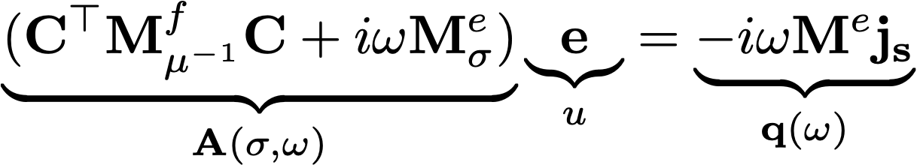
Solving an FDEM problem
Mesh types:
Tensor
OcTree
Curvilinear
Tetrahedral
J. Capriotti

Slide 10
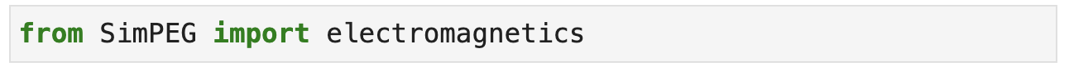
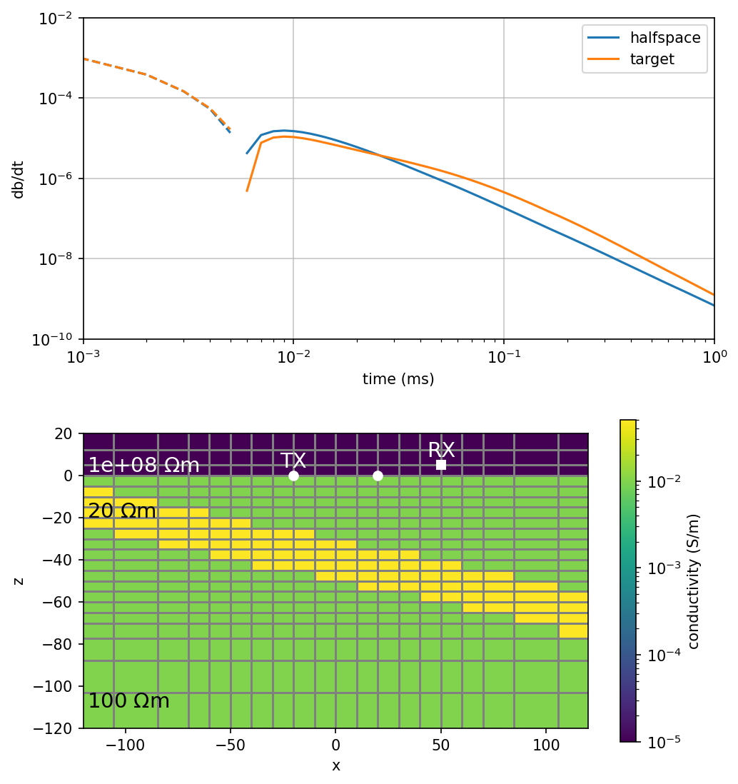
modules:
frequency domain
natural sources
time domain
physical properties:
supports anisotropic conductivity
variable magnetic permeability
IP parameters (1D fdem, tdem)
multiple formulations: E-B or H-J

Slide 11
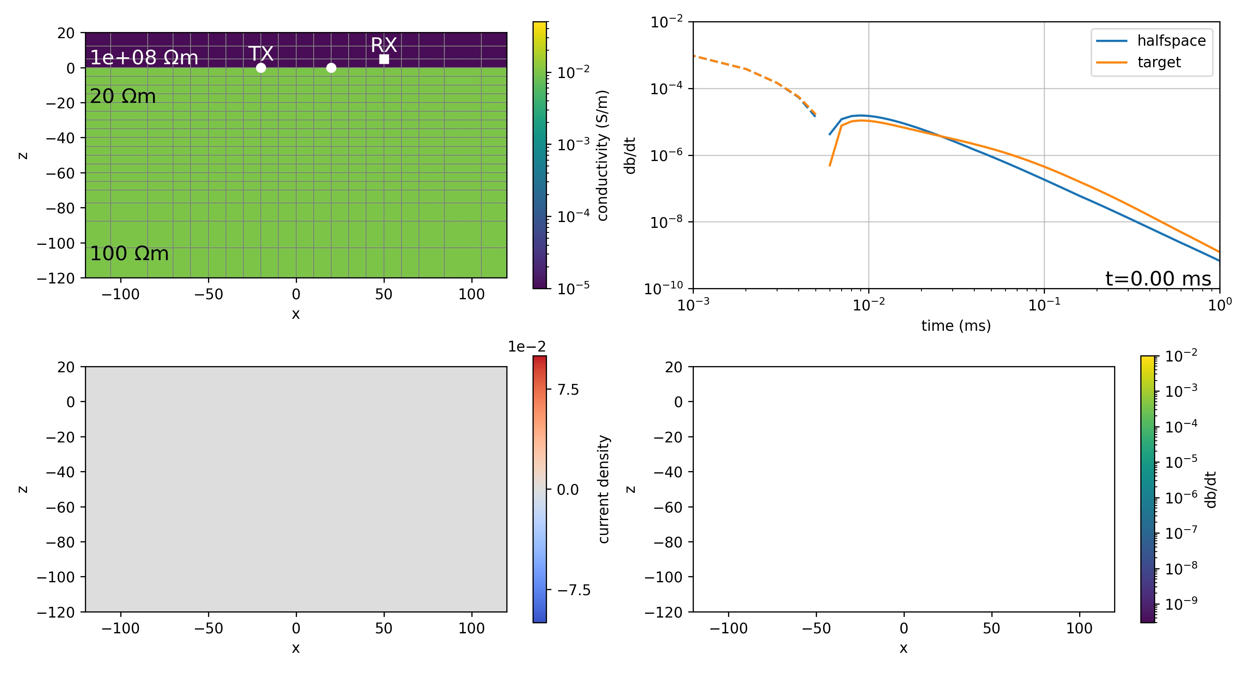

Slide 12
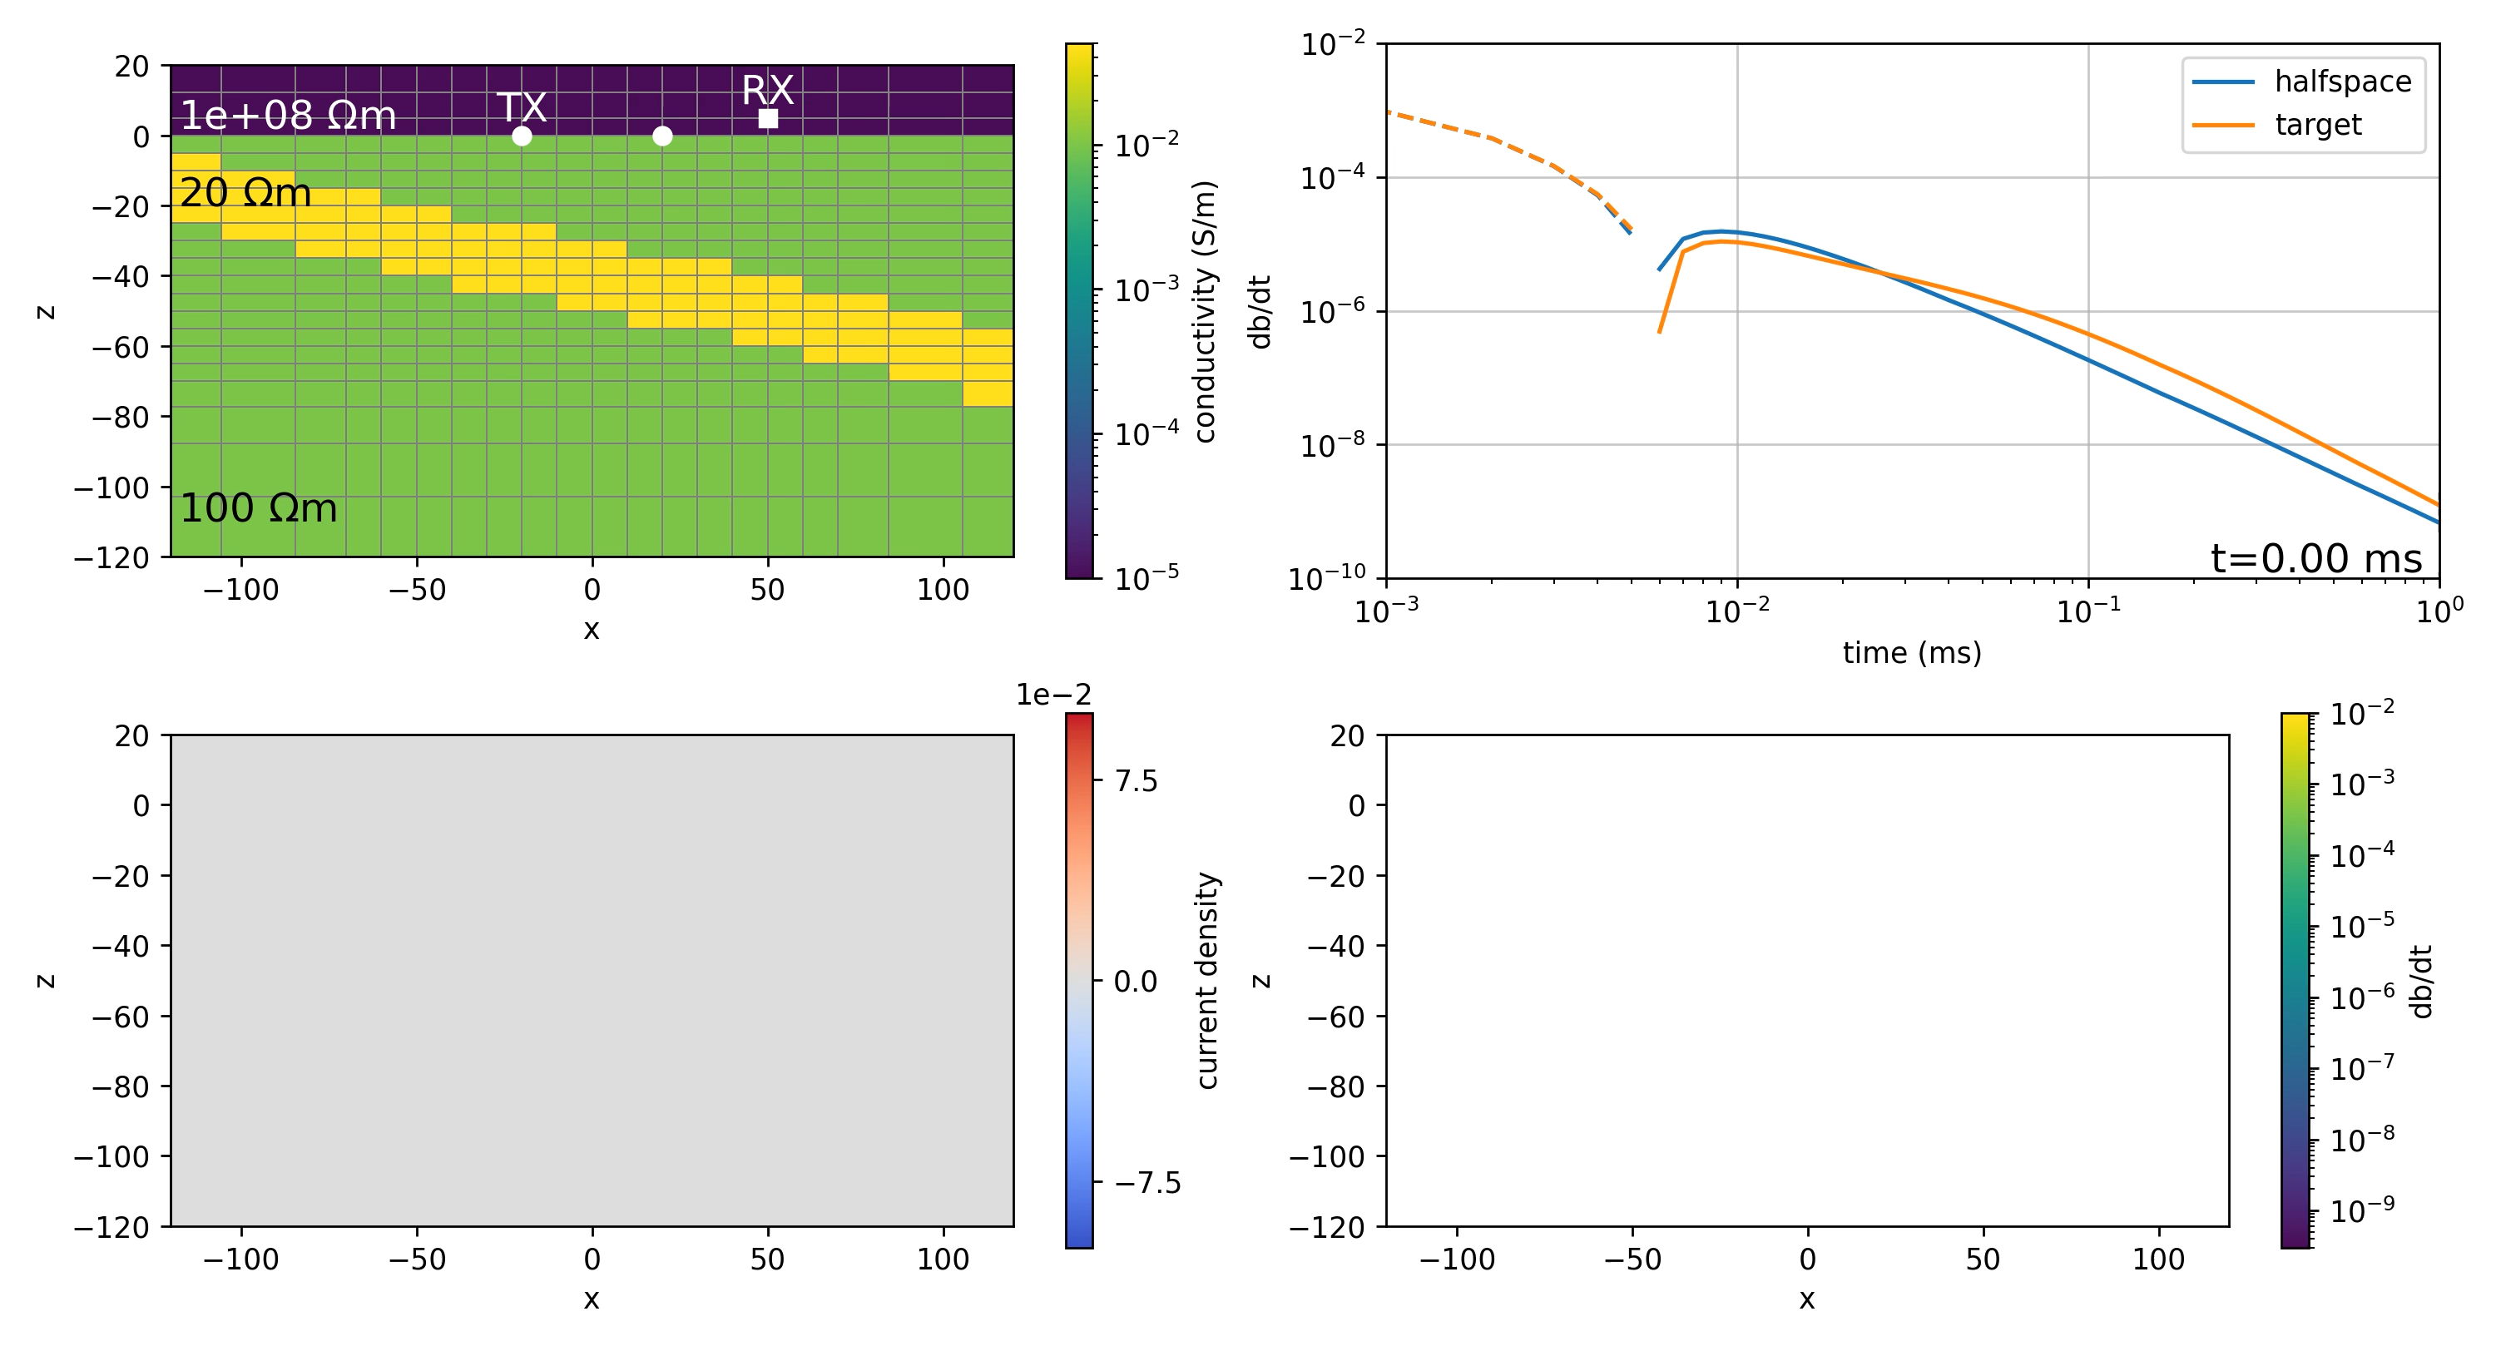

Slide 13
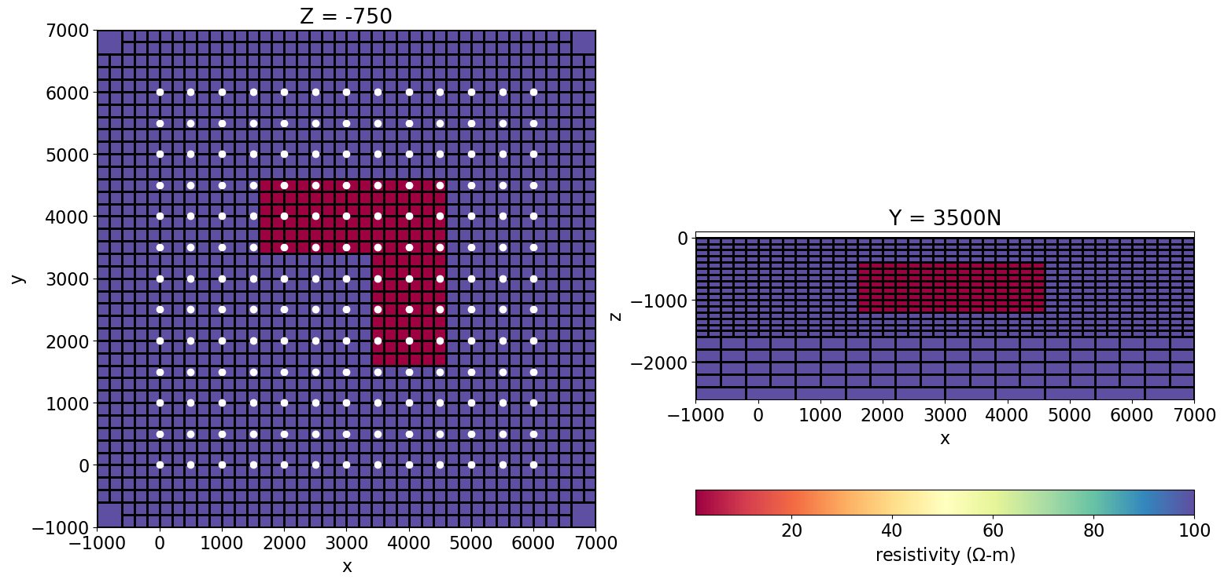
example: 3D simulation & inversion
model:
conductive L-block (1 Ωm)
half-space (100 Ωm)
survey:
natural source EM
frequencies: 10, 50, 200Hz
data: ZTEM

Slide 14
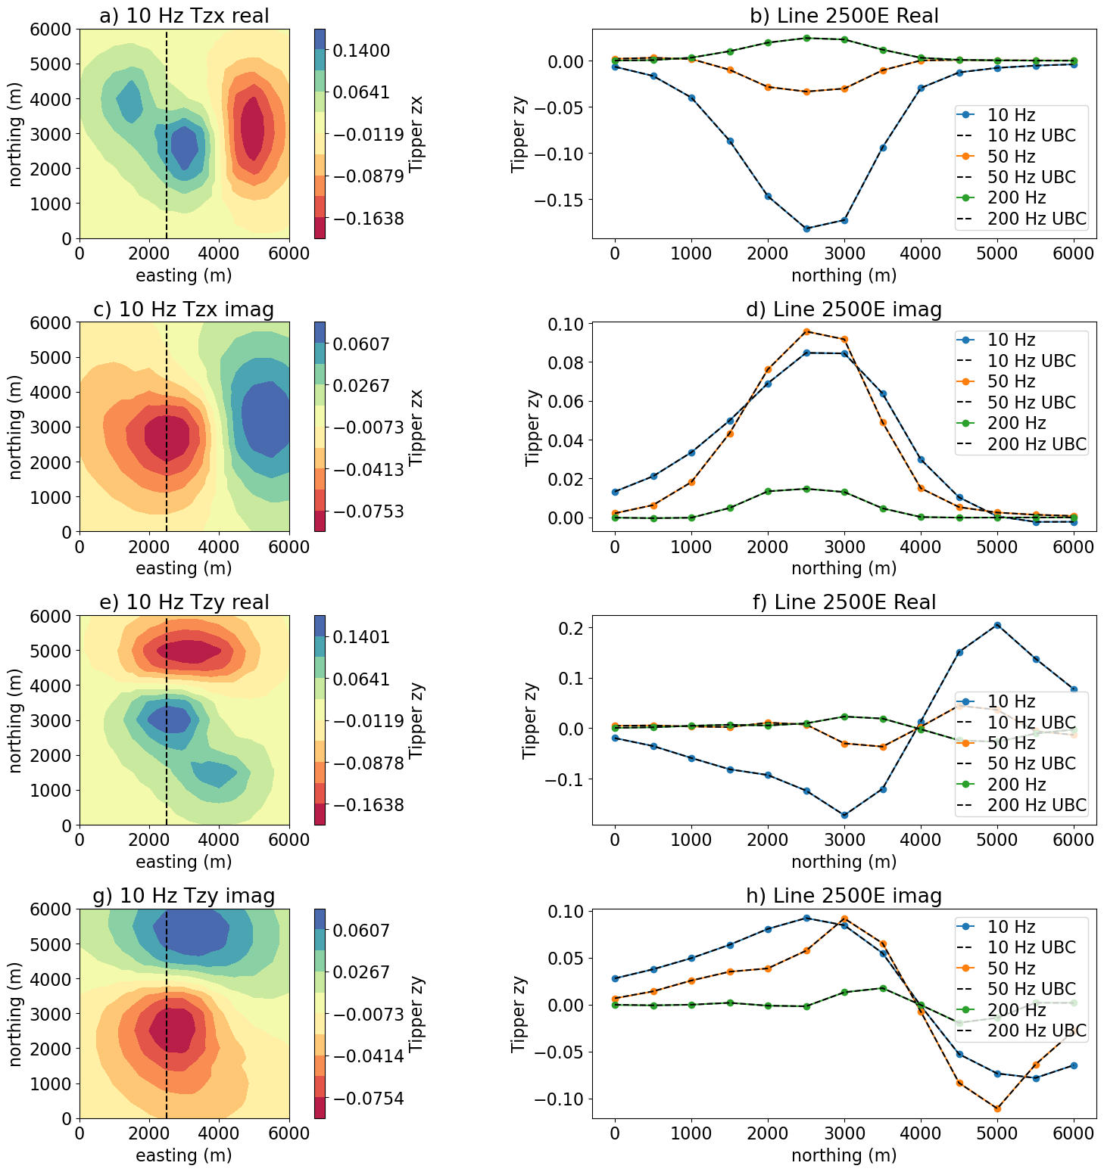
simulation
model:
conductive L-block (1 Ωm)
half-space (100 Ωm)
survey:
natural source EM
frequencies: 10, 50, 200Hz
data: ZTEM
simulation:
OcTree mesh
run SimPEG & UBC E3DMT

Slide 15
inversion
data
2028 data
uncertainties:
5% relative error
floor: 0.01 for 10 Hz, 50 Hz data, 0.005 for 200 Hz data
regularization
L₂ smooth model
identical beta-cooling schedule

Slide 16
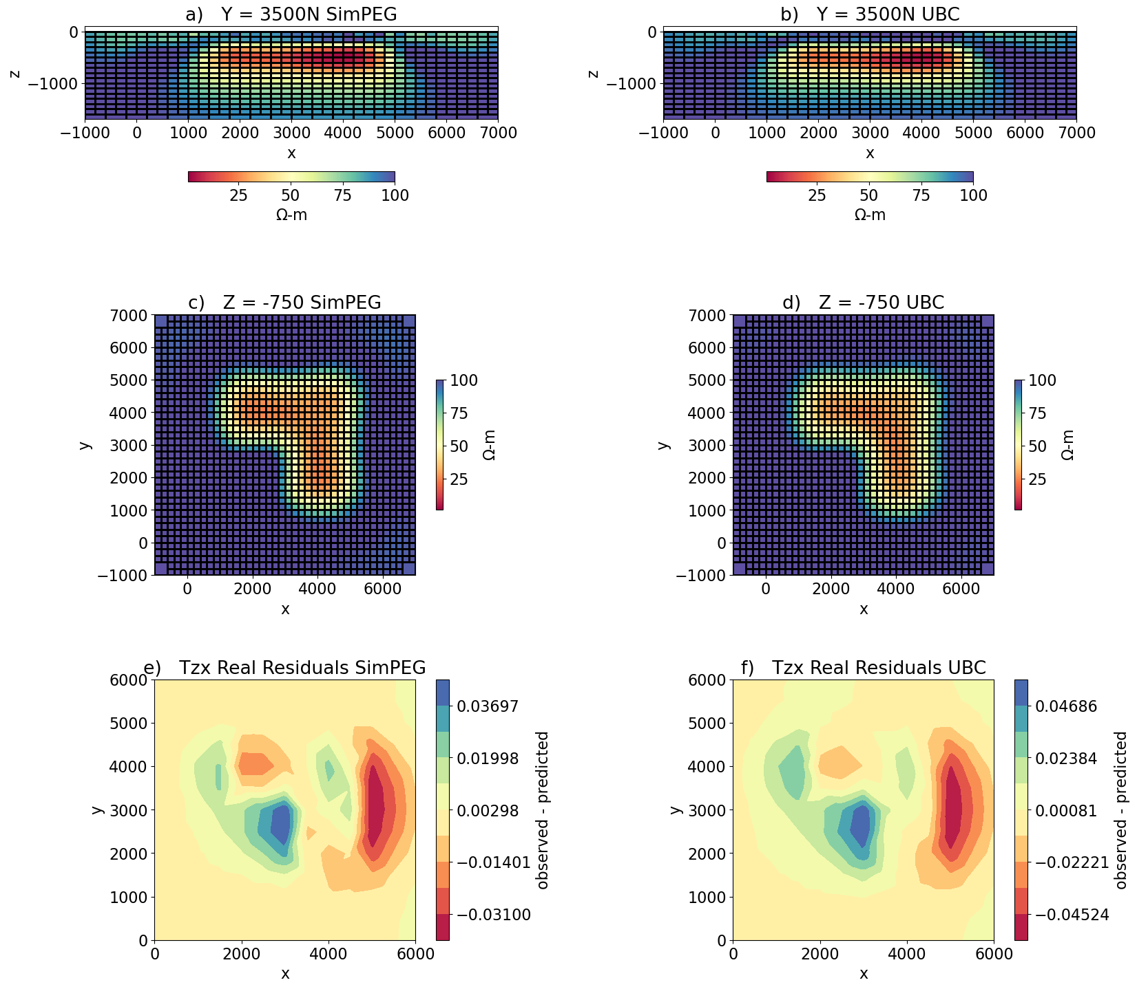
inversion
SimPEG
7 iterations
final χ-factor of 0.47
parallelized with Python multiprocessing
runtime: 15 minutes
UBC E3DMT
8 iterations
final χ-factor of 0.55
parallelized with MPI
runtime: 11 minutes

Slide 17
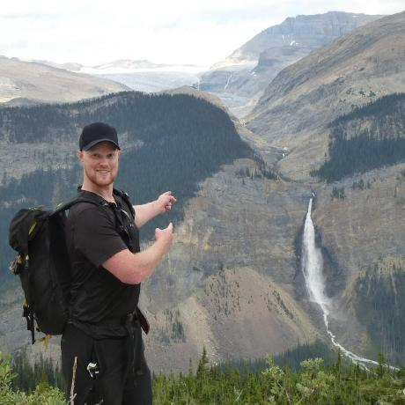
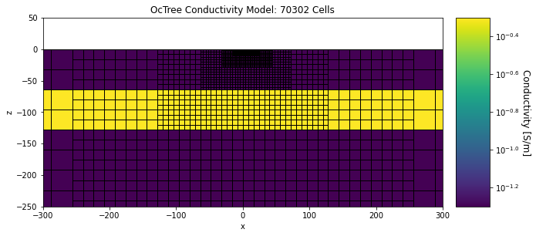
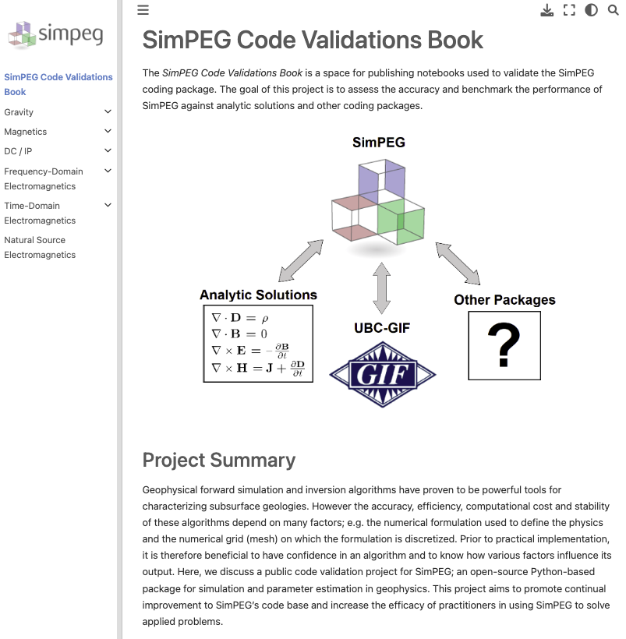
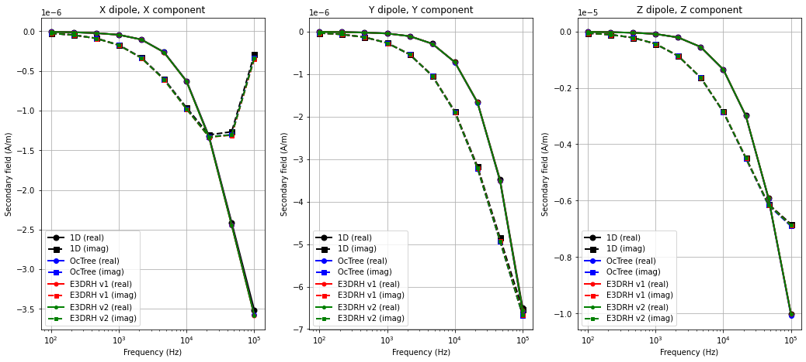
code validations
compare analytic, UBC Fortran, SimPEG
fdem dipole:
z=5m
separation: 10m
D. Cowan
simpeg.xyz/validations

Slide 18
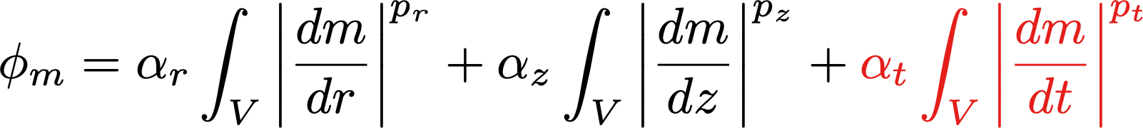
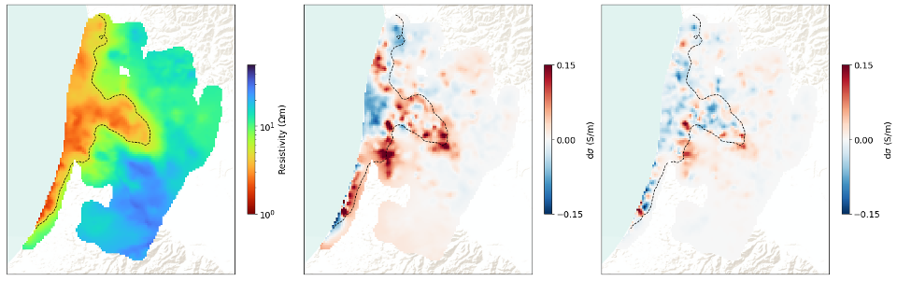
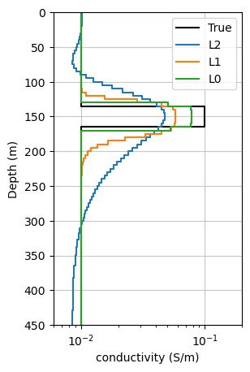
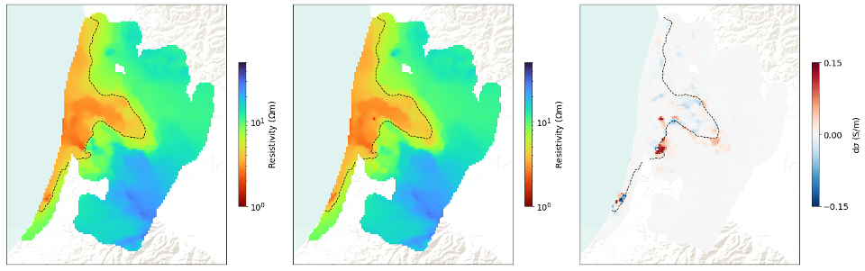
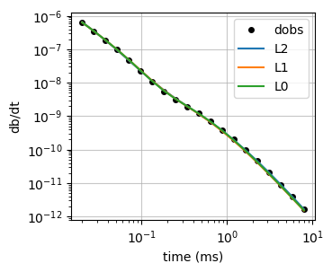
example: AEM inversion with sparse norms
S. Kang
seawater intrusion: TDEM over Salinas Valley in 2017, 2019
spatially constrained 1D inversions
introduce time-constraint
L₀ in space & time
lateral
vertical
time
difference.
no time constraint
difference.
L2 time constraint
2017
difference.
L0 time constraint
2017
2019
Kang & Knight, 2022; Kang BCGS talk 2022

Slide 19
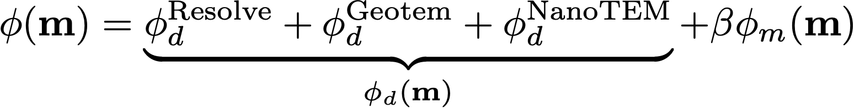

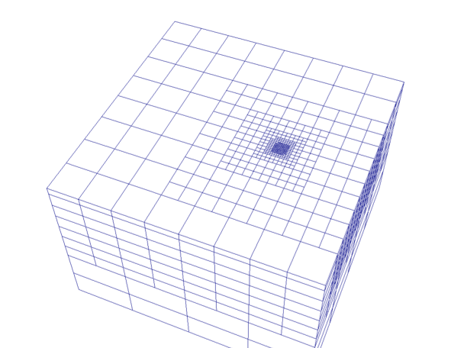
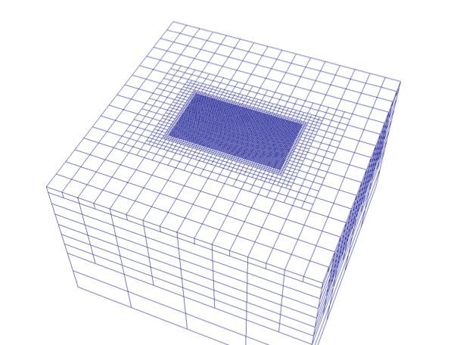
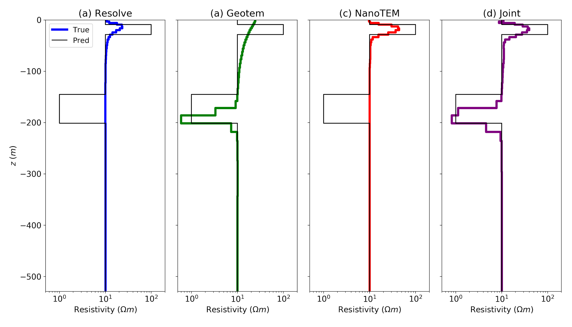
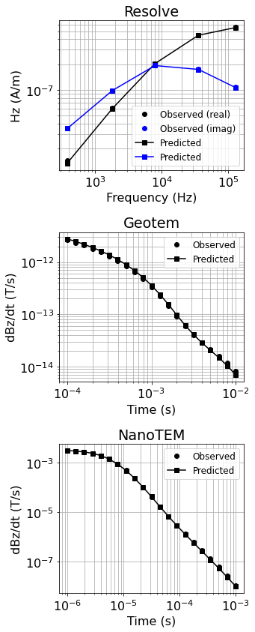
electromagnetics: advanced capabilities
Parallelization via domain decomposition
Sparse / compact norms
Parametric inversions
Petrophysically & Geologically Guided Inversion (PGI)
Joint inversions
same physical property
cross gradient, joint total variation, PGI
(Oldenburg et al, 2020)

Slide 20
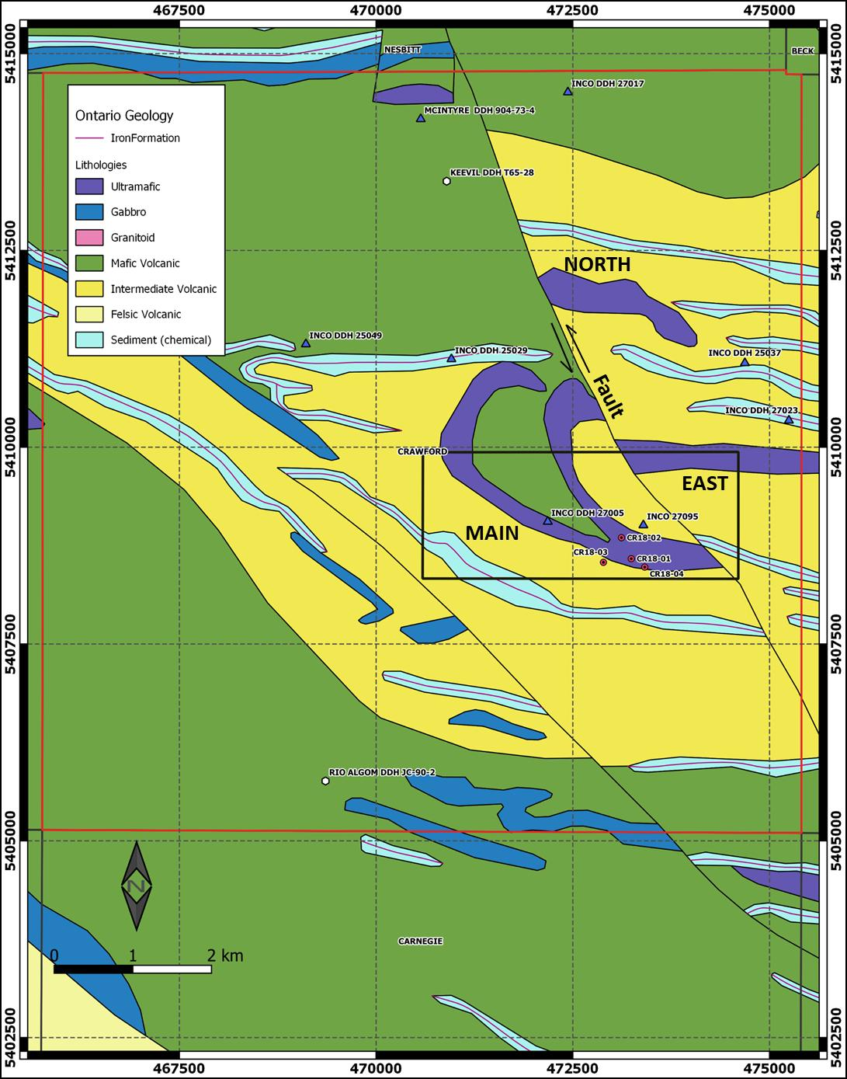



now and the future
locating serpentinized rock: quasi-geology model from multiple geophysical data sets
where we are…
1D inversions: spatial constraints, sparse norms
3D inversions: fdem & nsem comparable to UBC fortran, tdem still some efficiency improvements
joint inversions: cross-gradient, joint total variation, PGI
where we are going…
tutorials, efficiency, simplifying code
lots of research!
model
research drives development
partnerships with industry
MIT license: use, adapt, commercialize
Individual inversions
serpentinized
PGI inversion
susceptibility
density

Slide 21


getting connected
docs: docs.simpeg.xyz
newsletter: newsletter.simpeg.xyz
slack group: slack.simpeg.xyz

Slide 22



thank you! … and join us at 3DEM-7
email: lheagy@eoas.ubc.ca
slides: bit.ly/heagy-2023-aem
https://3dem-7.geosci.xyz
This work is licensed under a Creative Commons Attribution 4.0 International License.

